Slide 1


Pitch EMPRESA DE ELEVADORES
ALGORITMOS E ESTRUTURAS DE DADOS
Beatriz Aguiar up201906230
Margarida Vieira up201907907
Matilde Oliveira up201906954

Slide 2
PITCH
Description
Pitch is a company that manages, not only a set of lifts, but also their owners, Pitch's Clients. These lasts, can be of type Entrepreneur or Particular Client. The company works with a vast number of Employees, more specifically Service Providers, and Contracted Employees. The Service Providers are responsible for the exceptional execution of the maintenance. The need for maintenance is automatically controlled by the system, based on specific functioning control parameters. However, if and when desired, the owner is free to schedule a maintenance execution for his lifts. In both cases, the maintenance will be assigned to the Service Provider with less maintenances executed or to the one with higher evaluation. The Contracted Employees plays the role of lift manager. Once an Entrepreneur enters the Pitch data base, a Contracted Employee, that by default is the one with currently less Entrepreneurs associated, and who he can review anytime he wants, is associated to him. Pitch keeps track of all the lifts that have ever entered the data base which means that, once a Client is removed from it, the lifts he owned are automatically transfered to the company's name. Additionally, if the one removed is an Entrepreneur, his association with the Contracted Employee is canceled. Also, if an Employee is selected to be removed, one of two scenarios can happen. If the Employee is a Service Provider, his scheduled maintenances will be reassign, following the same criteria mentioned above. If the Employee is a Contracted Employee, his associated Entrepreneurs, if so exists, will be associated to another Contracted Employee whose selection, once again, will respect the criteria mentioned above.
AEDA Grupo 2 Turma 4

Slide 3
Implementation
PITCH
Pitch
Pitch
This is where all data is stored.
HashTableClient clients;
Vector<Employee*> employees;
heapEmployeesSP serviceProviders;
heapEmployeesCE contractedEmployees
BST<MaintenanceRecord> maintenances;
Vector<Lift*> lifts;
Vector<Lift*> ownedLifts;
Maintenance
Each maintenance is identified by its liftcode and respective service provider nif.
Important parameters:
static Time duration;
Date appointment;
Time schedule;
bool finished;
Employee
All employees have an evaluation (1-5) & an identifier (nif).
According to its salary, na employee can be a Service Provider or a Contracted employee.
Service Provider’s function is the lift’s maintenance.
perHourSalary & hoursWorked
numMaintenances & heapMaint schedule;
Contracted Employee’s are associated to Entrepreneurs.
perHourSalary
Vector<Client*> clientsAssociated
Utils.h
This header file is used for the implementation of helpful utilities and algorithms.
class Date
class Time
Sequential Search
UserInterface
This class is where all the magic happens. As the name suggests, this class implements the connection between the user and the Pitch Company.
Office
The user can access the Pitch Company Office & insert, remove or analyse the company’s data.
Building
The user can choose a lift to “travel” in. We tried to make it as realistic as possible.
Exception
Exception class will be thoroughly explained later.
ClientDoesNotExist
EmployeeDoesNotExist
LiftDoesNotExist
NotAnEntrepreneur
InvalidDate
InvalidTime
InvalidNumFloors
Lift
Each lift is identified by its code, static parameter.
It has a few other identifiers, such as its adress & client’s nif.
Important parameters:
static doorOpens
vector<Moves>movesHistory;
vector<Maintenance*> maintHistory;
int regularTime;
Client
According to its nif,,the identifier, a cliente can be an entrepreneur or a particular cliente.
Entrepreneurs have their own lift manager (Employee).
Both clientes store owned lifts.
vector<Lift*>lifts;
Lift
Maintenance
struct Moves{
Date date;
int from;
int to;
int floorCount;
Time tInitial;
Time tFinal;
};
Client
Employee
class MaintenanceRecord{
Maintenance *maintenance;
};
Utils
class ContractedEmployeeType{
ContractedEmployee *ce;
};
class ServiceProviderType{
ServiceProvider *sp;
};
Exception
UserInterface
AEDA Grupo 2 Turma 4

Slide 4
Implementation
PITCH
Pitch
User Interface
Office
Buildings
Show Pitch Data
Add Clients & Employees
Remove Clients & Employees
Register Client data
Buy new lifts
Evaluate employee
Request maintenance to owned lift
Show lifts
Choose a building
Call lift
Go up/down the stairs
EnterBuilding()
Choose Building
Call lift
Go up/down the stairs
Call maintenance
AEDA Grupo 2 Turma 4

Slide 5
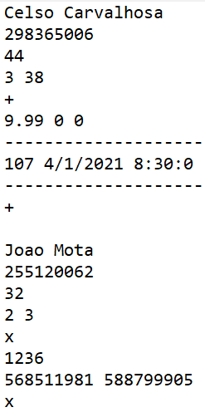
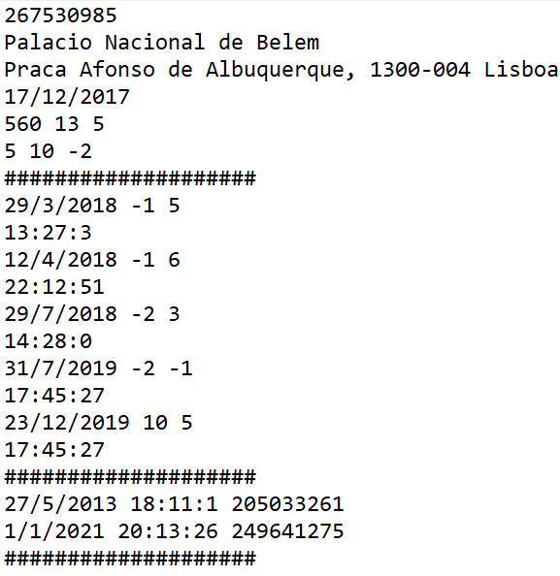
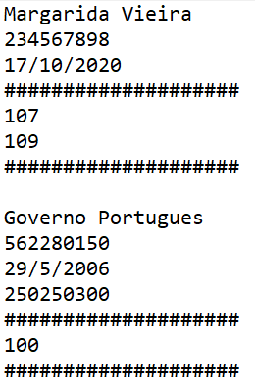
Ficheiros
PITCH
Employees
name
nif
age
evaluation numReviews
+ (+ symbol indicates Service Provider)
perHourSalary hoursWorked numMaintenances
--------------------
--------------------
+
ou
x (x symbol indicates Contracted Employee)
perMonthSalary
clientNif1 clientNif2….
x
Lifts
clientNif
buildingName
install
capacity nFloors regularTime
currentFloor higherFloor lowerFloor
####################
movesHistory
####################
maintHistory
####################
Clients
name
Nif
firstLift
employeeNif (if Entrepreneur)
####################
lifts (identificados pelo code)
####################
date from to
time
date hour nifEmployee
If Entrepreneur has no clientes: 0
AEDA Grupo 2 Turma 4

Slide 6


Bst
Maintenances
CRDU
Create
Read
Delete
Update
Why ?
Why MaintenanceRecord?
Ordered by:
Date
Schedule
Lift code
MaintenanceRecord Maintenance*
AEDA Grupo 2 Turma 4

Slide 7

HASH TABLE
Clients
CRDU
Create
Read
Delete
Update
Hash Function:
$$37 ∗v+client.getNif();$$
AEDA Grupo 2 Turma 4

Slide 8
Priority queue
Employees
CRDU
Create
Read
Delete
Update
Ordered by:
Number of maintenances executed
Evaluation
ServiceProviderType ServiceProvider*
Ordered by:
Evaluation
Number of clients associated
ContractedEmployeeType ContractedEmployee*
AEDA Grupo 2 Turma 4

Slide 9
Star of the show
PITCH
Time can’t stop Pitch
Past, Present & Future is in our control.
Schedules future lift maintenances.
Deals with maintenances in real time automatically.
Achieves all data.
AEDA Grupo 2 Turma 4

Slide 10
Overview
PITCH
Programming
conquests
Challenges && Evaluation
No relevant challenges as we learnt from our last mistakes.
Worked perfectly well together.
100/3% for each.
Binary Trees.
Hash Tables.
Priority queues.
AEDA Grupo 2 Turma 4

